Slide 1
Example of citizen activist use of OpenData against a project of french government decree on advertising regulations : true, recent (and well ending) story !
Notes:
Hello
welcome I want to tell you a true story, in which I was involved last year, and at that occasion I learned a lot about how things work in our society...
To make it short, the french government wanted last year to change the regulations on outdoor advertising, and presented a decree project : everythings was nicely and gently presenty “we just want to modernize” “it wont change anything” “we just want to make things simpler” but in fact it was very different, and was the result of the work of lobbies which prepare everything in background...
And it took a lot of time and energy to understand, evaluate, and demonstrate that this decree project was insane, very bad in fact, and a long time to convince it to give up
So this speech is not a proof of open government, on the contrary I would say, because this project decree was secretly prepared, was the result of lobbies work, the dark side of te government!
But on the other hand, the opendata made available by another part of the french government, the clear side of the government, helped to evaluate and counter this government project.

Slide 2

- To protect lanscape against the proliferation of advertising billboards
- Only legal actions : awareness, mediation, files to courts
- Successfull organization : 71 successes in trial (on 71)
- Non profit, no subsidy, only volunteers
Notes:
I m a member of Paysages de France , I m militant at paysages de France
- French non profit organization which advocates the landscape against the proliferation of advertising billboards, (rules exist but are not respected).
- Association approved at the Ministry of the Environment
- Only legal actions : awareness campaigns, training actions, mediations
- Investigation files to courts : managed to condemn the french state 71 times, 71 successes on trial on 71 attempts : each time the french state is condemned because it does not enforce regulations, that it has ifself decided and set into place.
succeeds in removing thousands of unlawful billboards from the french lanscape
Succeeds in keeping under soem little control the advertising companies which are very powerful, a lot of money, a lot of power
- Non profit organization, no subsidy, only volunteers

Slide 3
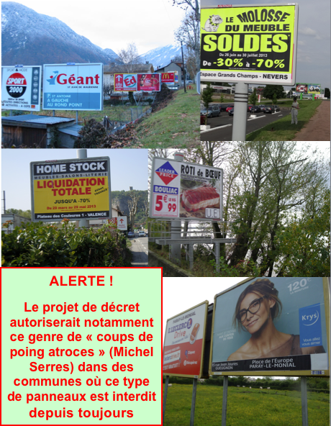

A government decree project in 2015 promises large landscape horrors ...
Notes:
But advertising lobbies regularly want to make evolve regulations in their favor, that's what happen in sept 2015.
A project decree has been prepared in French ministry of Economy, and almost sure result of the work of lobbies which regularly want to make evolve the regulations in their favour. Advertising lobbies are very powerful, large financial interests are at stake. Several companies, subsidiaries of large american companies.
Several new articles want to challenge and destroy current regulations.
But project decree is unclear, difficult to understand, it adds complexity, and it is not evaluated at all. Impossible to understand what it means, impossible to know the exact impact.

Slide 4
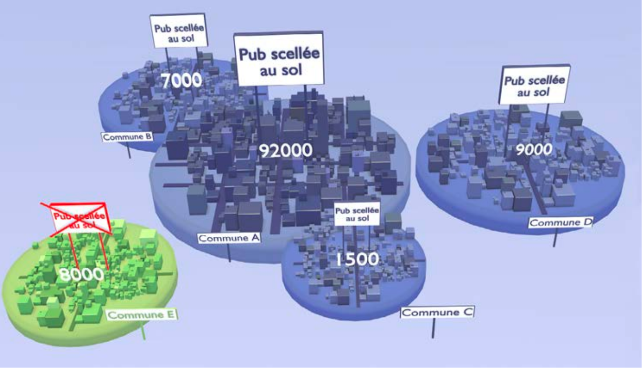
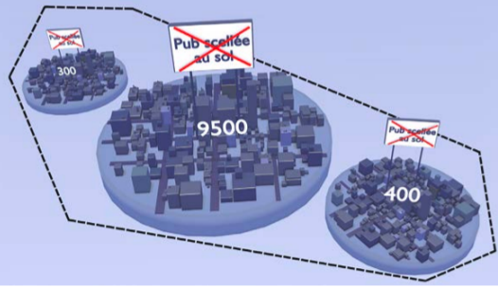
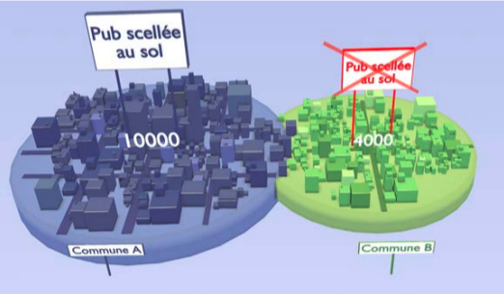
Explanations of current rules, and what was supposed to change
>100 000 inhabitants
<10 000 inhabitants
<=
This was supposed to change, but was not evaluated
Around >10 000 inhabitants
Notes:
Today grounded advertising billboards are totally forbidden in rural space, outside or urban area.
Today grounded advertising billboards are authorized in the 61 french urban entities which have more than 100 000 inhabitants
Today grounded advertising billboards are authorized
in the more than 500 cities which have more than 10 000 inhabitants.
Project decree wanted to extend the authorization of grounded advertising billboards to all cities which are part of a urban entity, which center town has more than 10 000 inhabitants.
Data to know the impact did not exist and needed to be computed by taking into account definition of french urban entities, population of towns, we needed to separate the place where it was already authorized from the place where it would have become authorized.
Moreover we needs to know all the towns which are part of a Regional Park and part of a urban entity of a town with 10 000 inhabitants or more
Several open data files (from Etalab) processed (urban entities,cities, populations of cities, regional parks definitions) to compute list of cities impacted.
Processings were done in bash to decorate vectorial map file, to build a Mapbox map with OpenStreetMap rendering.

Slide 5
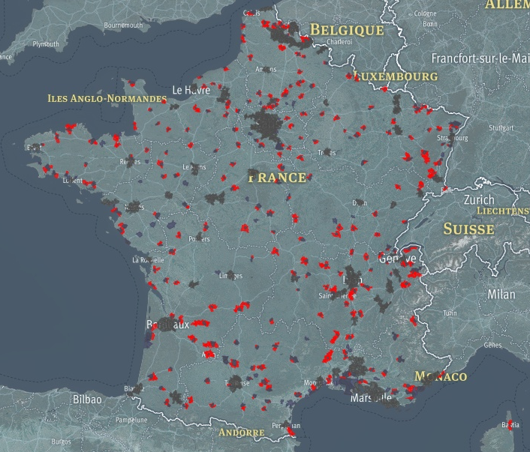
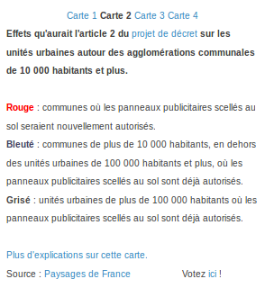
October 2015 : opendata & map (built over OpenStreetMap)
Notes:
The result is that 237 urban entities and 1149 cities are concerned !!
In blue or bluish, in grey
See map for french metropole
See map for Guyane/Guadeloupe/Martinique
See map for Reunion Island and Mayotte

Slide 6
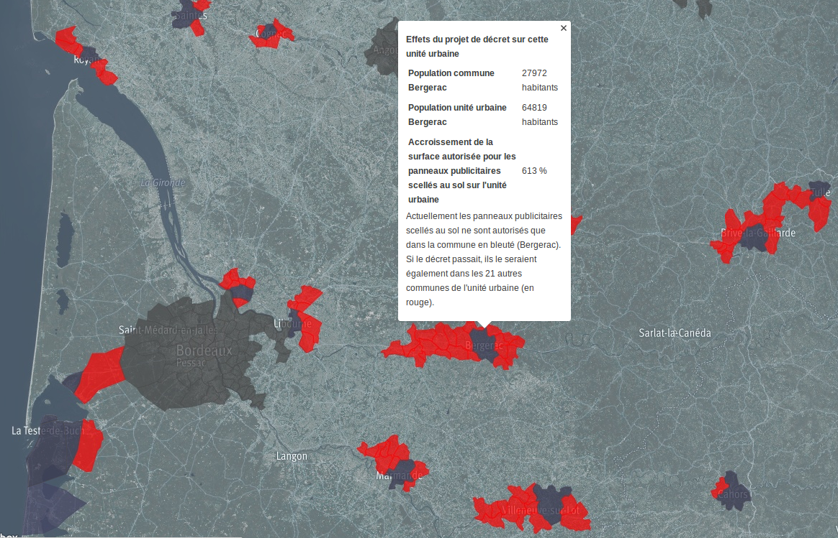
October 2015 : interactive map covers all France, and shows impacts for each town, each region.
Everyone can realize

Slide 7

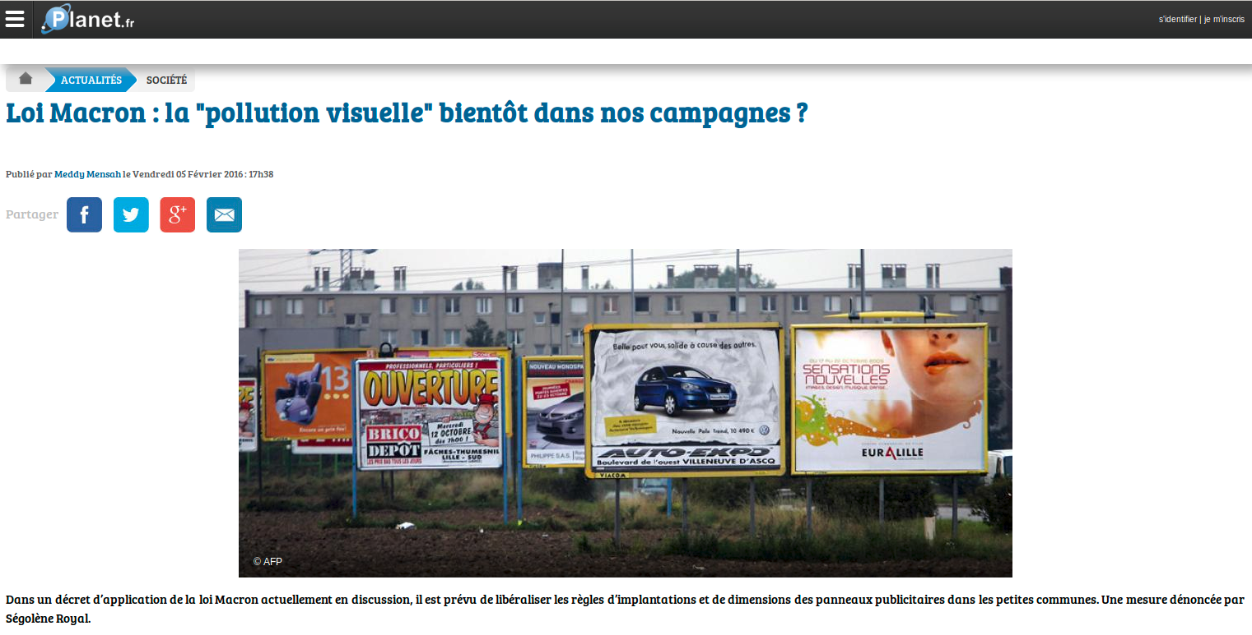
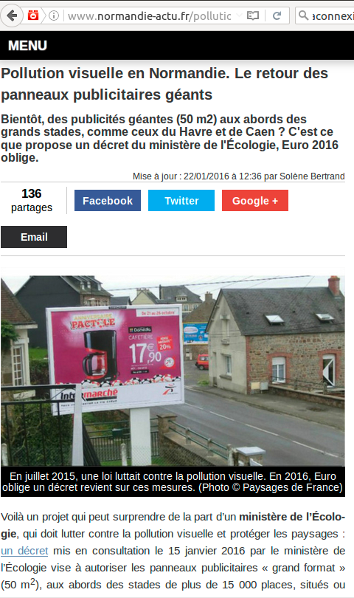

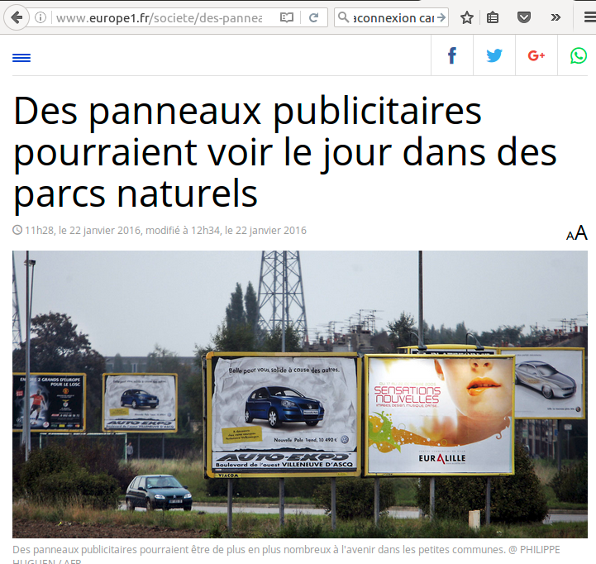
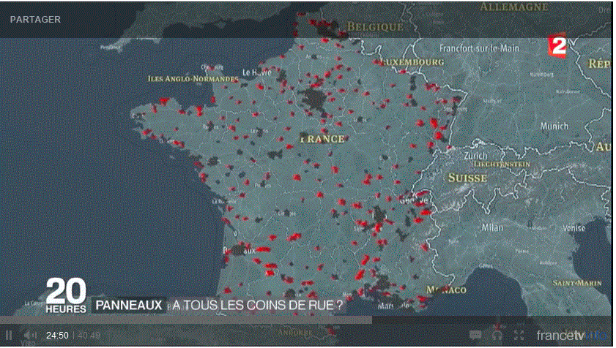
January 2016 : media bring the debate to the public space

Slide 8

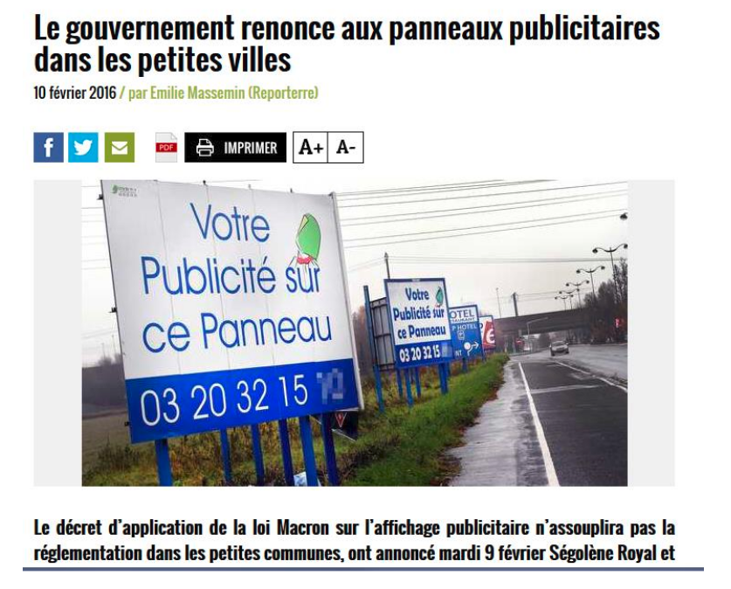

February 9th 2016 : government gives up, victory !

Slide 9
Progression of the fight (my personnal understanding)

Slide 10
Open data : unexpected use, sharing understanding, citizen participation, transparency, evaluation of public policy, counterweight ...
Welcome page of project http://pdfext.github.io/index.html
Participation to Etalab dataconnexion#6 contest https://www.data.gouv.fr/fr/reuses/evaluation-et-visualisation-dun-projet-de-decret-sur-laffichage-publicitaire/
Paysages de France : www.paysagesdefrance.org

